Slide 1
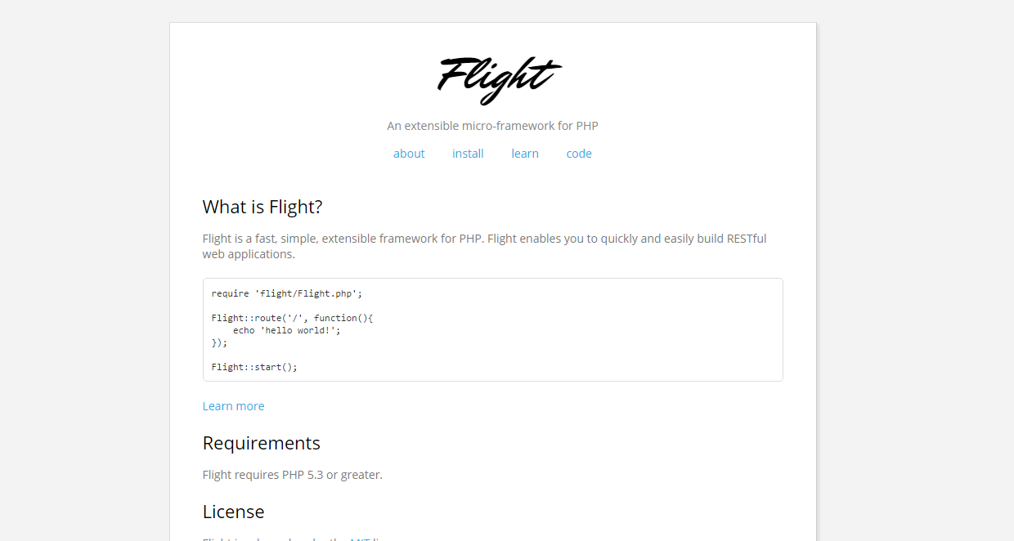
Flight PHP
Trang chủ: http://flightphp.com/

Slide 2
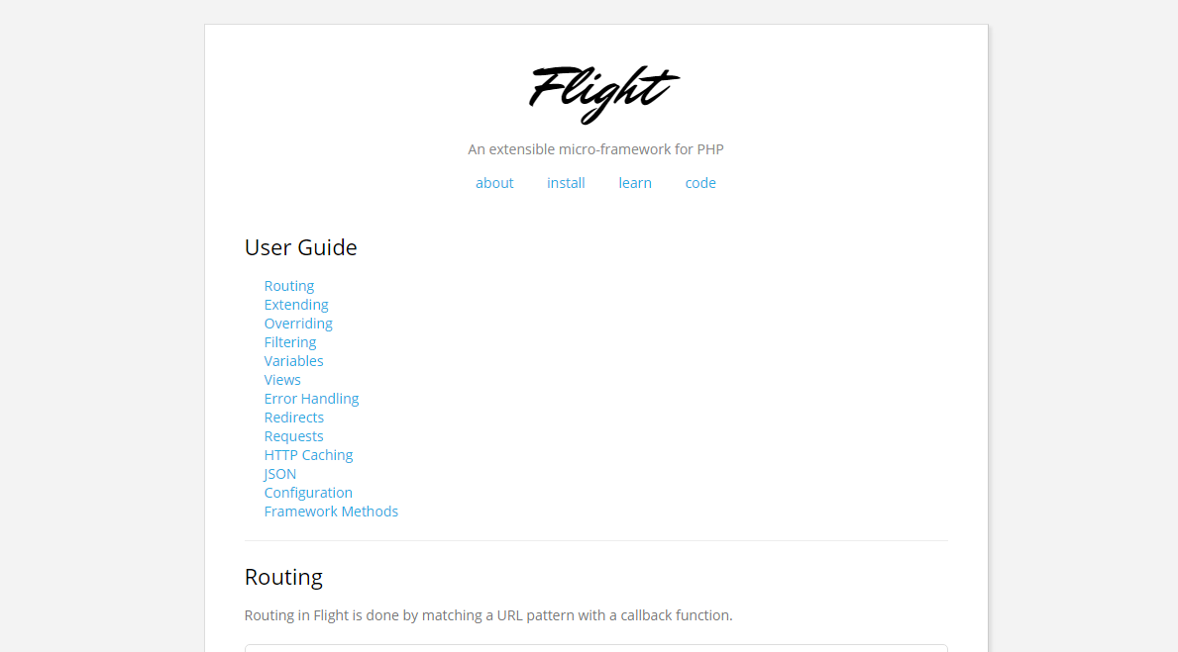
Start to learn Flight PHP
http://flightphp.com/learn

Slide 3
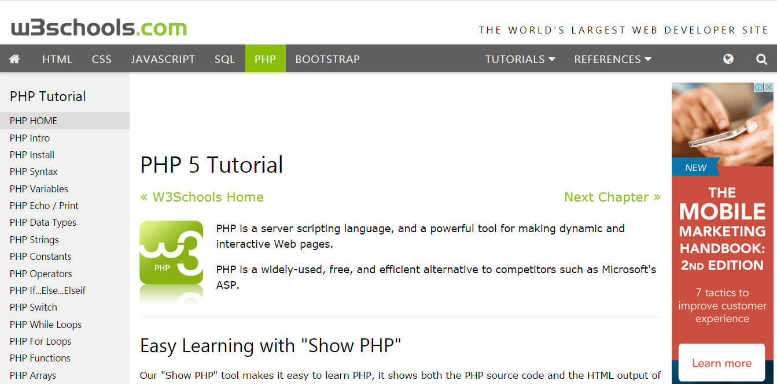
PHP tutorial: 3. http://www.w3schools.com/php/default.asp

Slide 4
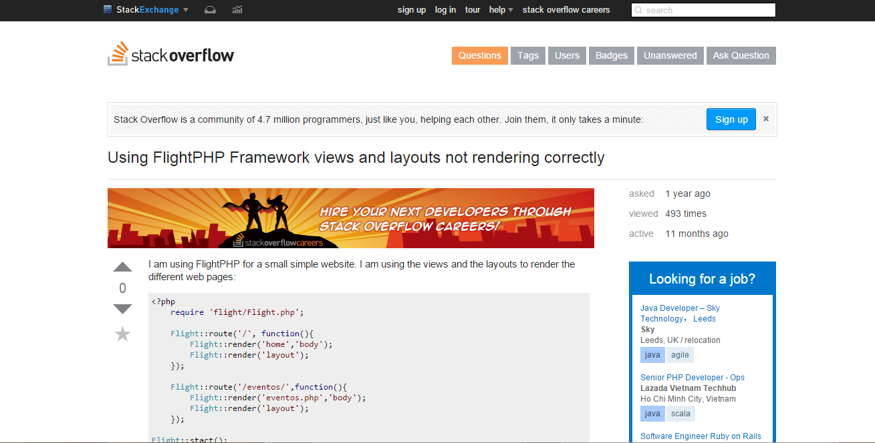
Flight PHP forums:
http://stackoverflow.com/questions/21295981/using-flightphp-framework-views-and-layouts-not-rendering-correctly

Slide 5
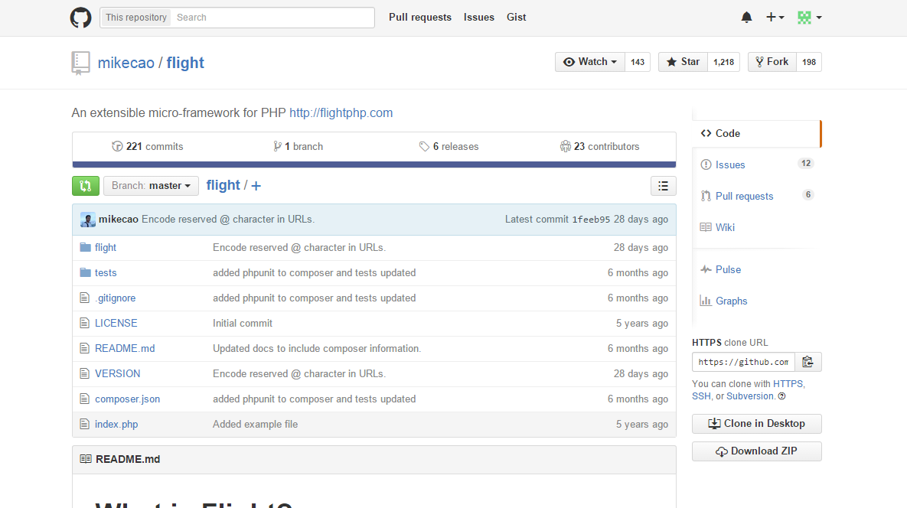
https://github.com/mikecao/flight

